Slide 1

Customer Shopping Behavior Analysis
Analyzing 3,900 customer transactions to uncover insights into spending patterns, customer segments, and product preferences that drive strategic business decisions.

Slide 2
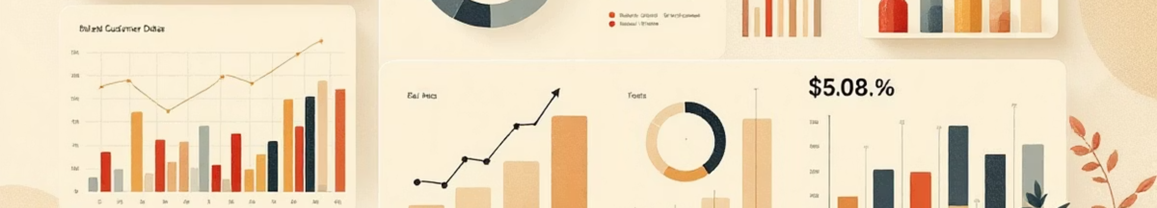
Dataset Overview
3,900
18
37
Total Purchases
Data Features
Missing Values
Transactions analyzed across all categories
Comprehensive customer and purchase attributes
Only in Review Rating column
Key features include customer demographics (Age, Gender, Location, Subscription Status), purchase details (Item, Category, Amount, Season, Size, Color), and shopping behavior (Discounts, Previous Purchases, Frequency, Review Rating, Shipping Type).

Slide 3

Data Preparation & Cleaning
01
Data Loading & Exploration
Imported dataset using pandas, checked structure with df.info() and summary statistics with .describe()
02
Missing Data Handling
Imputed missing Review Rating values using median rating of each product category
03
Feature Engineering
Created age_group column by binning ages and purchase_frequency_days from purchase data
04
Database Integration
Connected to PostgreSQL and loaded cleaned data for SQL analysis

Slide 4

Revenue Insights by Gender
Analysis revealed significant revenue differences between male and female customers, providing insights for targeted marketing strategies.
Understanding gender-based spending patterns helps optimize product positioning and promotional campaigns for maximum impact.

Slide 5
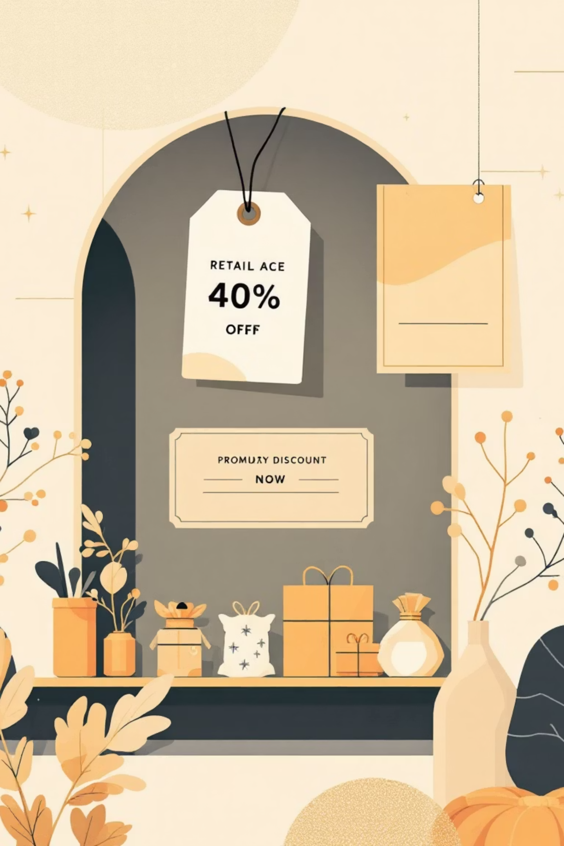
Discount Strategy Analysis
High-Spending Discount Users
Discount-Dependent Products
Identified customers who used discounts but still spent above average purchase amount
Found 5 products with highest percentage of discounted purchases
Strategic Implications
Balance sales boosts with margin control for optimal profitability

Slide 6
Product Performance
Top 5 Products by Rating
Top 3 per Category
Identified products with highest average review ratings for promotional focus
Listed most purchased products within each category for inventory optimization

Slide 7

Shipping & Subscription Insights
Shipping Type Comparison
Subscribers vs. Non-Subscribers
Express shipping users show different average purchase amounts compared to Standard shipping customers
Subscribers demonstrate higher average spend and total revenue contribution
Repeat Buyers & Subscriptions
Customers with >5 purchases show significantly higher subscription rates

Slide 8


Customer Segmentation
1
Loyal
2
Returning
3
New
Classified customers into three segments based on purchase history. This segmentation enables targeted retention strategies and personalized marketing campaigns to move customers up the loyalty pyramid.
Revenue by Age Group
Calculated total revenue contribution across different age demographics to identify high-value segments

Slide 9
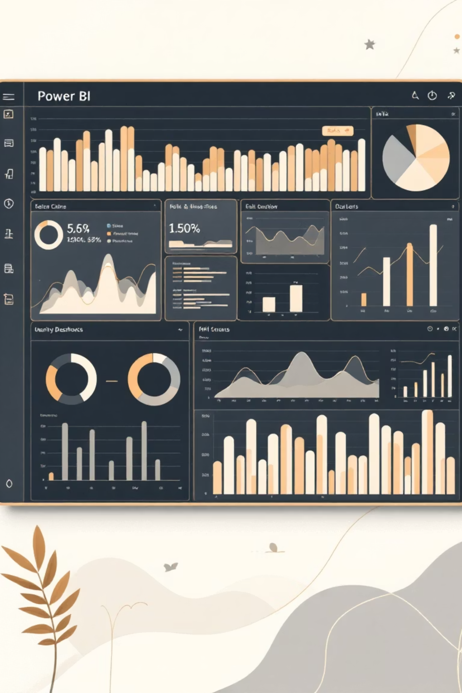
Interactive Dashboard
Built comprehensive Power BI dashboard presenting all insights visually with interactive filters for real-time exploration of customer shopping patterns, revenue trends, and product performance metrics.

Slide 10



Strategic Recommendations
Boost Subscriptions
Loyalty Programs
Targeted Marketing
Promote exclusive benefits for subscribers
Reward repeat buyers to move them into Loyal segment
Focus on high-revenue age groups and express-shipping users
Review Discount Policy
Product Positioning
Balance sales boosts with margin control for sustainable growth
Highlight top-rated and best-selling products in campaigns

